Slide 1
Main menu: (use case
Choose the town you want to edit from the dropdown, or select the “Add Town” option to add a new town:
Add Town
▼
Continue

Slide 2
Creating a new pub List: (use case – Start a new pub list/Add the name of a town for the new pub list)
Enter town name:
Back to Menu
Add pubs
Notes:
Would like to replace back to menu with a home button (picture of a house, or menu?) need to check if its possible in java fx. Errors for this page might include highlighting the box in red and letting the user know they cant leave it blank, for example. After entering a town name the user will be sent to the add pubs page using the list they just added

Slide 3
Adding pubs to a list: (use case – edit a current pub list)
You are currently adding pubs to Aberystwyth’s list.
Name:
Description:
▲
▼
GPS Coordinates:
Choose location
Characteristics:
Select a characteristic…
True
False
▼
You have added the following characteristics: Dog Friendly, Real Ale
Photos:
Manage Photos
Back to Menu
Save changes and return to Menu
Add next pub
Notes:
Pressing back to menu should give a warning message letting the user know that their changes will be lost. Should also highlight areas which the user has not filled in correctly and provide helpful messages, eg “You must upload a photo”. After designing this page I think it looks a little crowded, might be worth separating
Over multiple pages, separate page for photos and characteristics maybe? Pressing manage photos will open a popup window allowing users to add photos. Return to Menu should take the back to the main menu if they added a new pub, or back to the edit list page if they were editing a specific pub list.

Slide 4
Editing an existing pub list: (use case – Edit a current pub list)
You have loaded Aberystwyth’s list.
Add Pub(s)
View/Edit Pubs
Delete Pub(s)
Back to Menu
Add next pub

Slide 5
Delete a Pub: (use case – Deleting a pub)
Select a pub to remove:
Select a pub to delete…
Delete Pub
▼
Back to Menu
Notes:
After deleting a pub the dropdown should swap back to displaying “Select a pub to delete…” and the user should be able to delete another pub. A confirmation window will pop up, asking the user if they are sure they want to delete it, as it removes everything (including photos) and is non-reversable.

Slide 6
Editing a pub: (use case Editing the details of an existing pub)
Select a Pub to edit:
The Cambrian
▼
Name:
The Cambrian
Description:
A student focused bar, equipped with a pool table and a wide selection of drinks, most created by various society's from the university.
▲
▼
GPS Coordinates:
Edit location
Characteristics:
Welsh
True
False
▼
You have added the following characteristics: Dog Friendly, Real Ale
Photos:
Manage Photos
Back to Menu
Save changes
Use case – Save the edited pub list, or discard the changes
Notes:
All of the textboxes will be disabled and interactable until the user selects a pub from the dropdown menu, at which point the textboxes will fill with the pubs details. Clicking manage photos will bring up a popup window, see next slide.

Slide 7
Manage photos:
Currently uploaded photos (max 5):
cambrian_outside.png
Remove
cambrian_inside.png
Remove
Add new photo:
Upload file
Choose file
Finish
Notes:
After choosing a file it will be added to the list of photos, with its own delete button. Choosing to delete a photo will bring up a warning box with the options cancel and delete, letting the user know that

Slide 8

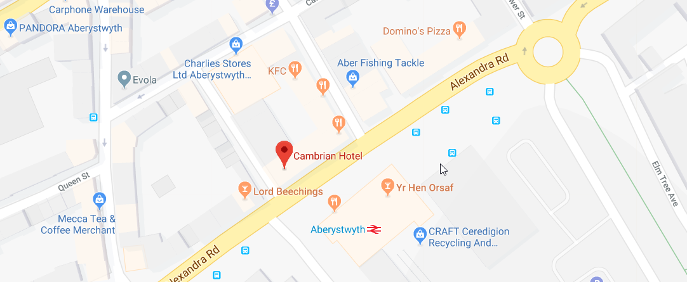
Edit/choose Location:
Please Select a Location:
Close without saving
Save and close
Image taken on google maps:
Notes:
When pressing Choose location and edit Location buttons this window will popup, allowing the user to browse google maps and select a location. The GPS coordinates of this location will be saved for future use. (Im sure we will be able to make the searchbar and the map display together naturally, after we do some more research on how to embed google maps)

